Slide 1

Links and Images
Links: the <a> tag
Images: the <img> tag
Organizing web files

Slide 2
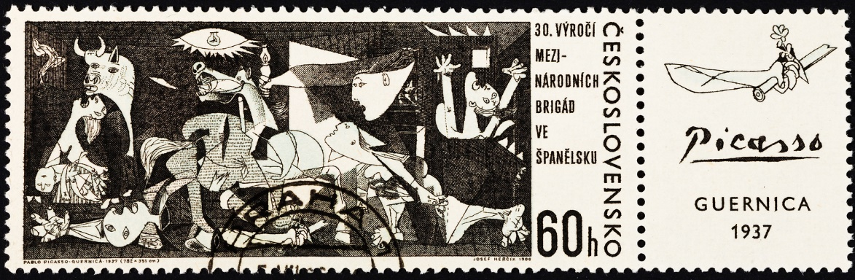
See Also
https://www.w3schools.com/tags/tag_a.asp
https://www.w3schools.com/html/html_images.asp
https://www.w3schools.com/tags/tag_img.asp

Slide 3

In the Book
Chapter 2:
Going Further with
Hypertext

Slide 4
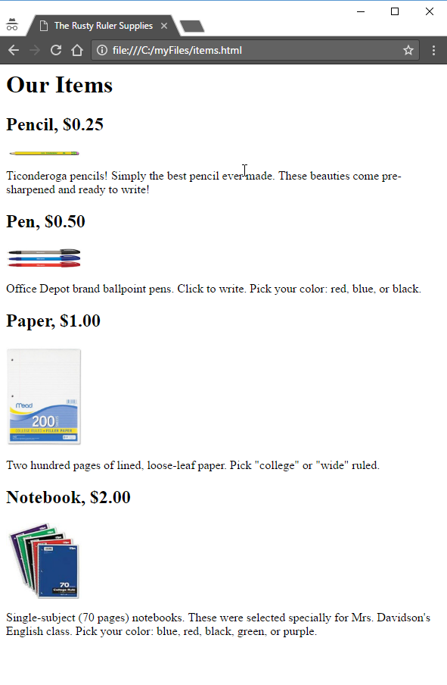
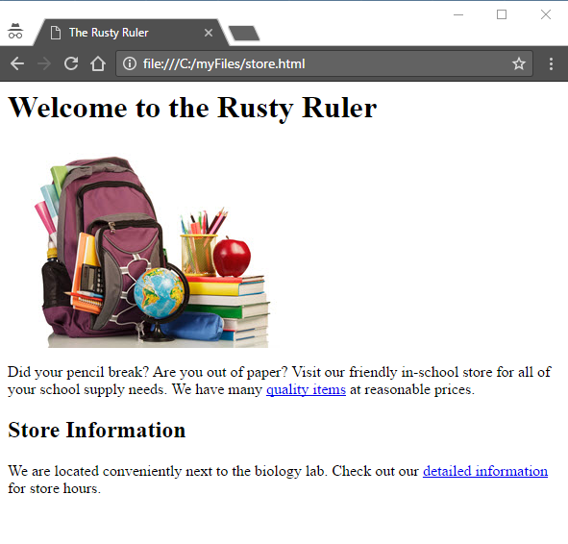
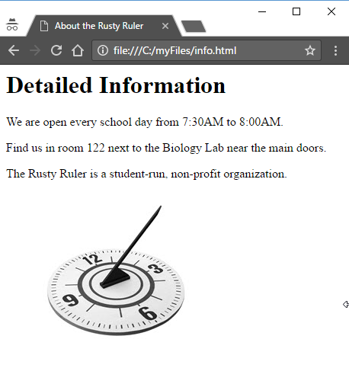
The Rusty Ruler
Streams of bytes … two ways (into your program and out of your program)
Disks, consoles, sockets, keyboards, printers
Know how to talk streams and you can talk to anything
Initialization (constructor) is different. Use is the same.

Slide 5
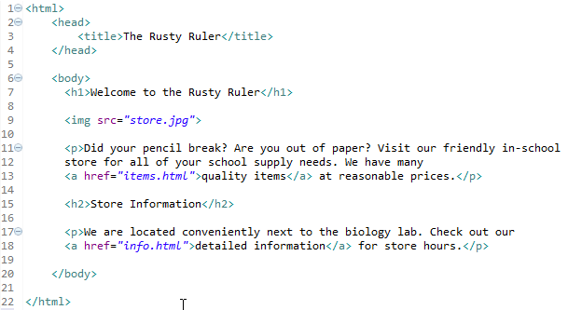
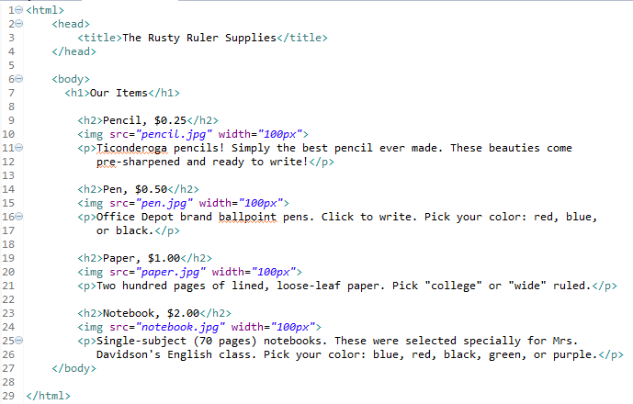
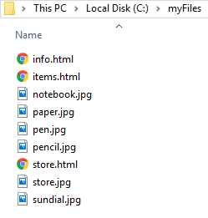
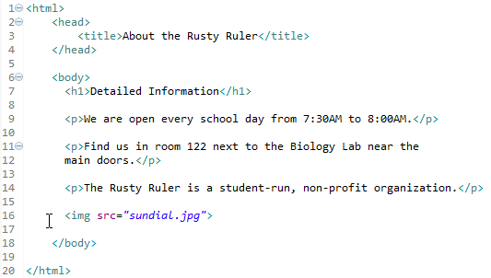



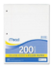
The Rusty Files
store.html
items.html
info.html
notebook.jpg
pencil.jpg
store.jpg
sundial.jpg
paper.jpg
pen.jpg

Slide 6
Anchors
<html>
<head>
<title>The Rusty Ruler</title>
</head>
<body>
<h1>Welcome to the Rusty Ruler</h1>
<img src="store.jpg">
<p>Did your pencil break? Are you out of paper? Visit our friendly in-school
store for all of your school supply needs. We have many
<a href="items.html"> quality items </a> at reasonable prices.</p>
<h2>Store Information</h2>
<p>We are located conveniently next to the biology lab. Check out our
<a href="info.html"> detailed information </a> for store hours.</p>
</body>
</html>

Slide 7
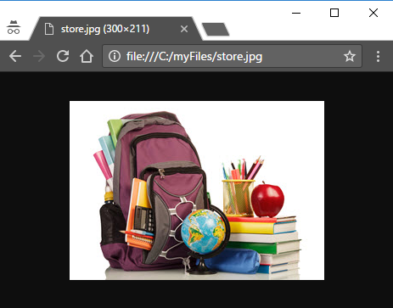
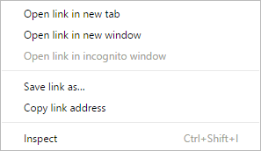
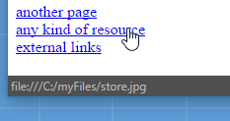
Anchors
<a href="items.html">another page</a>
<a href="store.jpg">any kind of resource</a>
<a href="http://google.com">external links</a>
Notes:
href is the “hypertext reference” – the destination to load when the link is clicked.
#1 The link could be to a text file or word document or image or anything. Often another HTML page.
#2 The link could be to an external resource
#3 When you hover over a link the browser will show you the destination in the bottom left. You may not have noticed that.
#4 You can right click to get open-options (tab or window) just clicking replaces the current resource with the destination #5 like this
#6 Whatever the href is becomes the new URL as if you had copied and pasted it in. And you can bookmark it
What if we want the image to appear on the page in line instead of all by itself?

Slide 8
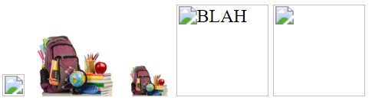
The <img> tag
<img src="store.jpg">
<img src="blah.jpg">
<img src="store.jpg" width="80">
<img src="store.jpg" width="40">
<img src="blah.jpg" alt="BLAH" width="80">
<img src="store.html" width="80">
Notes:
There is no “closing tag” like with the anchor. The “src” is the destination URL. The “src” could be an external URL.
As is the line shown places the store image on the page with its natural size.
#1 What happens if you have a bad URL? (or the URL has changed?)
#2 You get the little image place-holder from the browser
#3 There are several other optional attributes. The width is useful. Units are “pixels” It tells the browser to size the image width, and the height scales with it.
#4 Here are a couple of smaller “store” images
#5 The “alt” give you “alternate text” in case the image isn’t found or can’t be displayed
#6 Notice the browser still sets aside the 80x80 size. Now you see the alternate text. Since there is no “height” to scale, it assumes 80 height too.
How does the browser handle “src” that are not images? Give it a try:
#7 The store.html does exist
#8 But it treats it like an undisplayable image.

Slide 9
Attributes
<img src="blah.jpg" alt="BLAH" width="80">
name="value" – no spaces
Separate attributes with one or more spaces or newlines.
You can only use the attributes the browser expects for the element.
New to HTML5: many attributes are deprecated (moved to CSS)
New to HTML5: there are new attributes
New to HTML5: you can add your own “data-blahblah” attributes as needed.
Check the documentation.

Slide 10
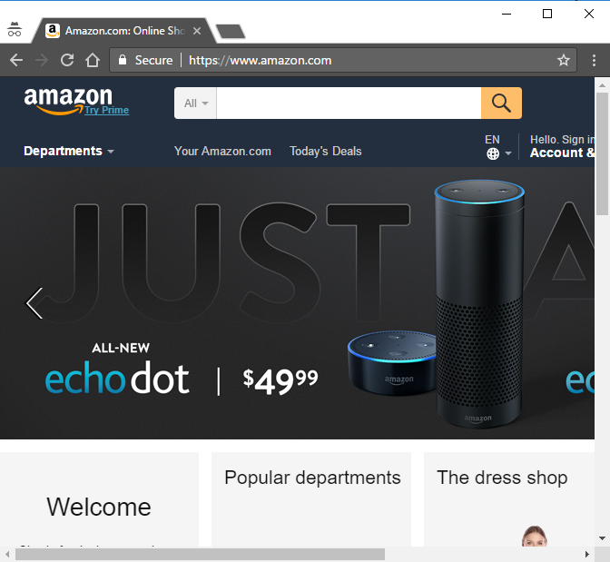
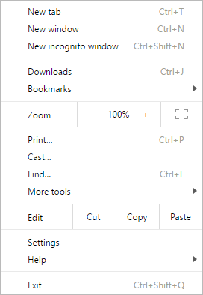
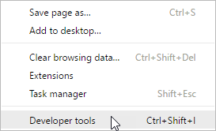
Developer Tools

Slide 11
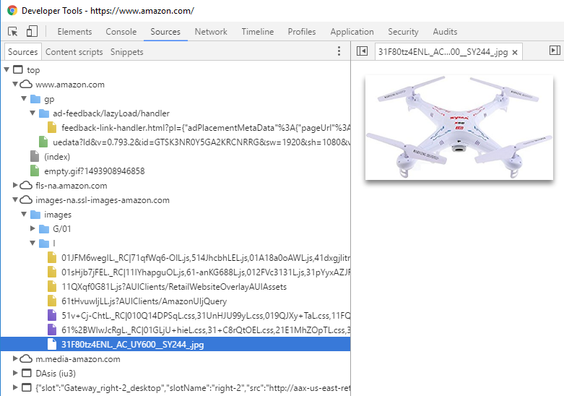
Amazon Layout
Notes:
#1 Lots of tabs of tools … all very useful … explore
The browser watches the URLs and shows the URL structure, which might loosely translate to directories.
#2 Here is the index.html loaded when you first get to the site
Lots of URL roots. Looks like the images are in separate directories “images” then “G/01” and “L”.
#3 You can click on resources here and the dev tool will show

Slide 12

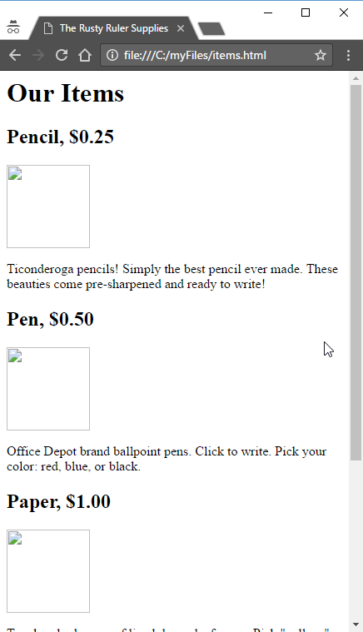
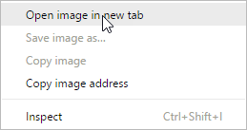
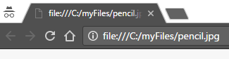
Organizing
C:
myFiles
The “root” of the content
store.html
items.html
about
info.html
images
store.jpg
pencil.jpg
pen.jpg
sundial.jpg
paper.jpg
notebook.jpg
12

Slide 13
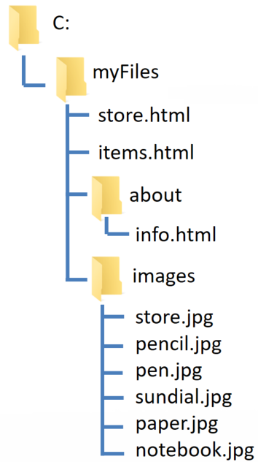
Broken Paths
store.html
<html>
<head>
<title>The Rusty Ruler</title>
</head>
<body>
<h1>Welcome to the Rusty Ruler</h1>
<img src="store.jpg">
<img src="images/store.jpg">
<p>Did your pencil break ...

Slide 14
Broken Paths
items.html
<h2>Pencil, $0.25</h2>
<img src="pencil.jpg" width="100px">
<img src="images/pencil.jpg" width="100px">
<p>Ticonderoga pencils!</p>
info.html
<p>The Rusty Ruler is a student-run, non-profit organization.</p>
<img src="sundial.jpg">
<img src="../sundial.jpg">

Slide 15


Paths
<img src="../images/sundial.jpg">
Go up to parent
<img src="/images/sundial.jpg">
Go up to root
Absolute paths are useful on the web server
<img src="/myFiles/../../some/other/sundial.jpg">

Slide 16
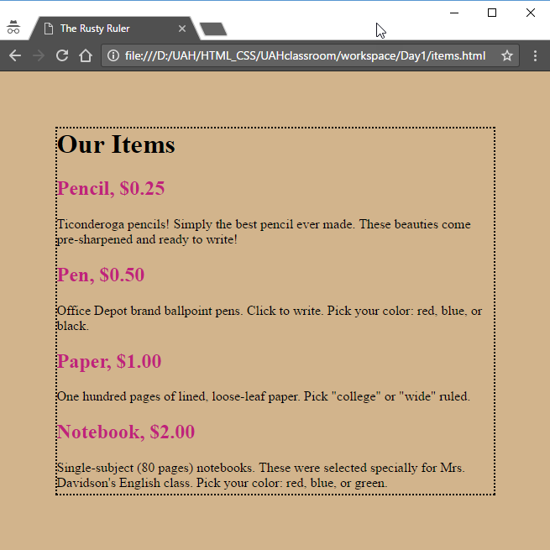
About Style (Later This Course)
<html>
<head>
<title>The Rusty Ruler</title>
<style>
body {
background-color: #d2b48c;
border: 2px dotted black;
margin: 10%;
}
h2 {color: #C0227B;}
</style>
</head>
<body>
<h1>Our Items</h1>
<h2>Pencil, $0.25</h2>
<p>We have Ticonderoga pencils! </p>
...
</body>
</html>
The <style> goes in the <head>
You can have multiple <style> tags
Controls presentation of various elements
Streams of bytes … two ways (into your program and out of your program)
Disks, consoles, sockets, keyboards, printers
Know how to talk streams and you can talk to anything
Initialization (constructor) is different. Use is the same.

Slide 17
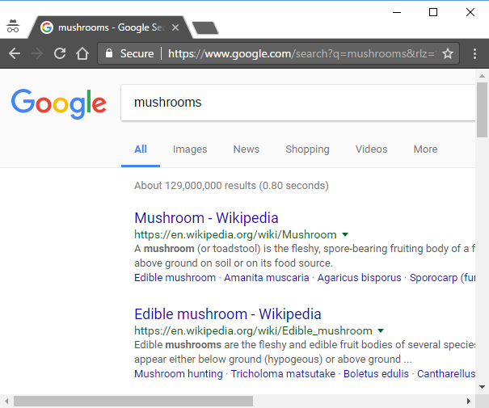
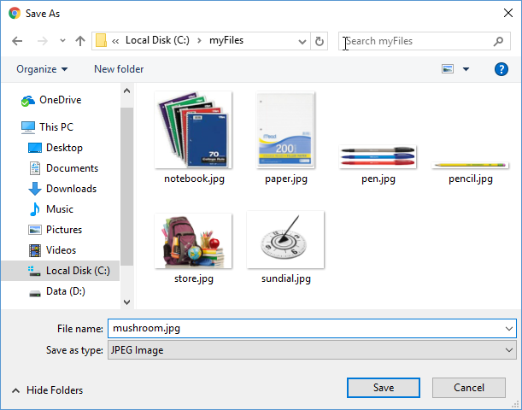
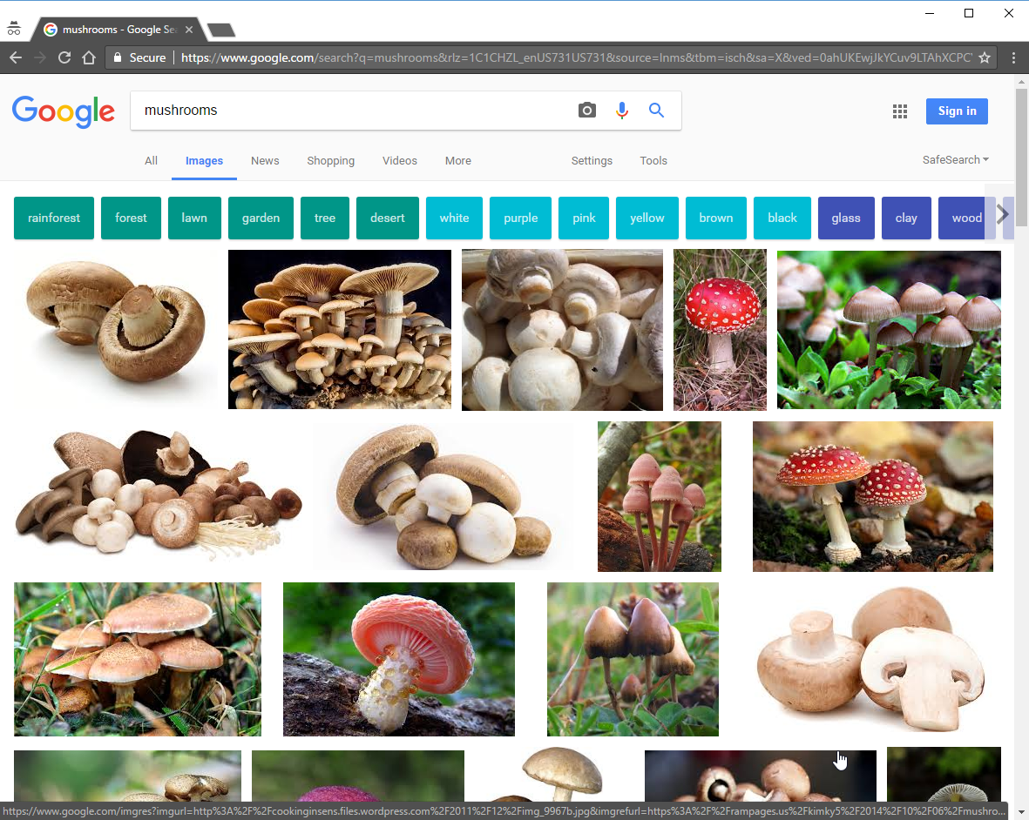
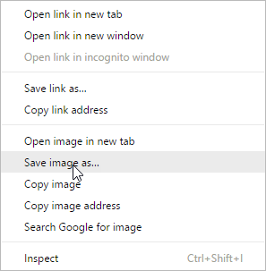
Finding Images

Slide 18
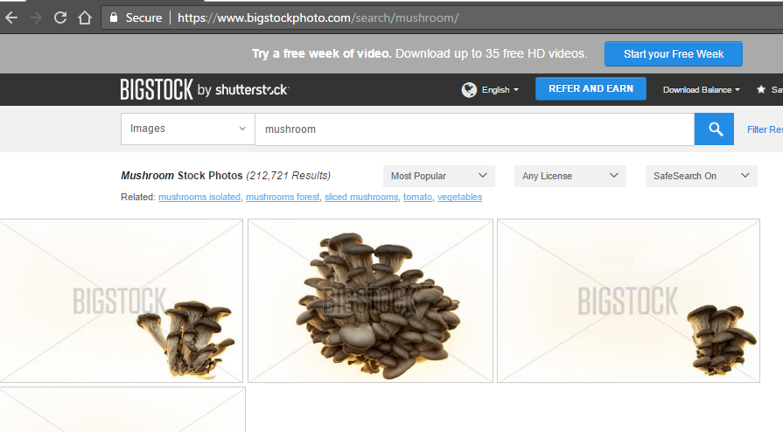
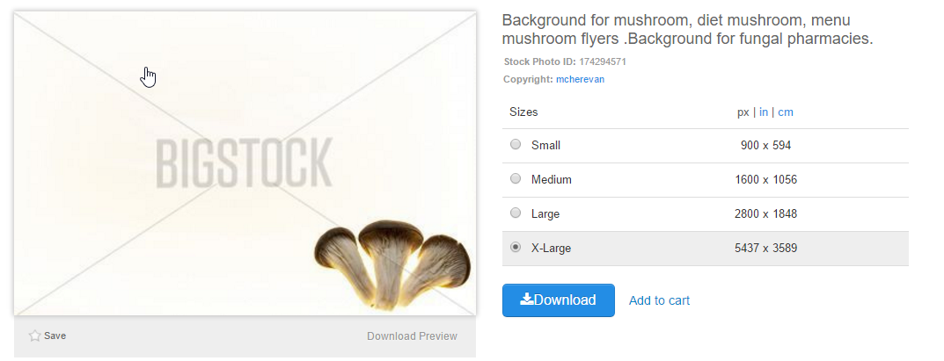
Finding Images
Images on the web may not be free
Get permission before you use an image

Slide 19
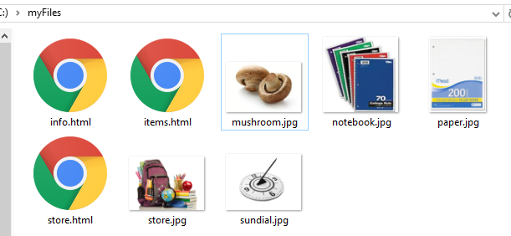
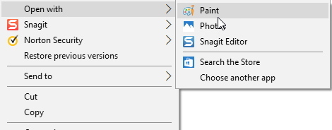
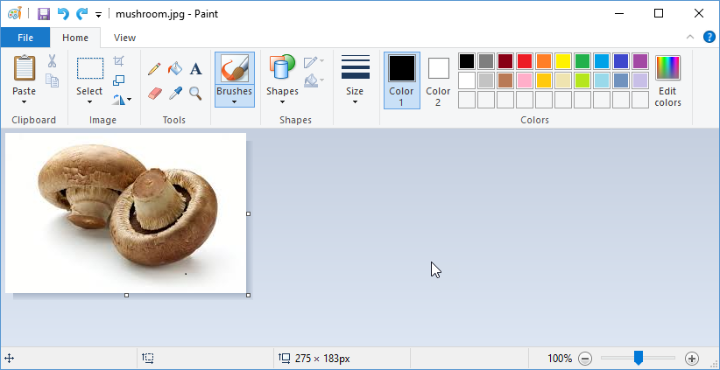
Editing Images

Slide 20
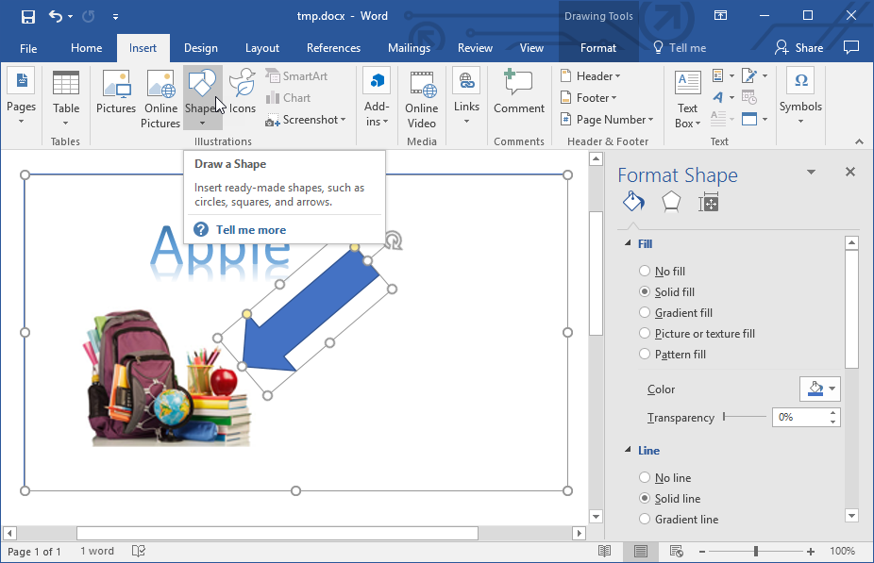
Editing Images
Paint
Photoshop
Snagit
(Camtasia)
Word Art
Open Office

Slide 21
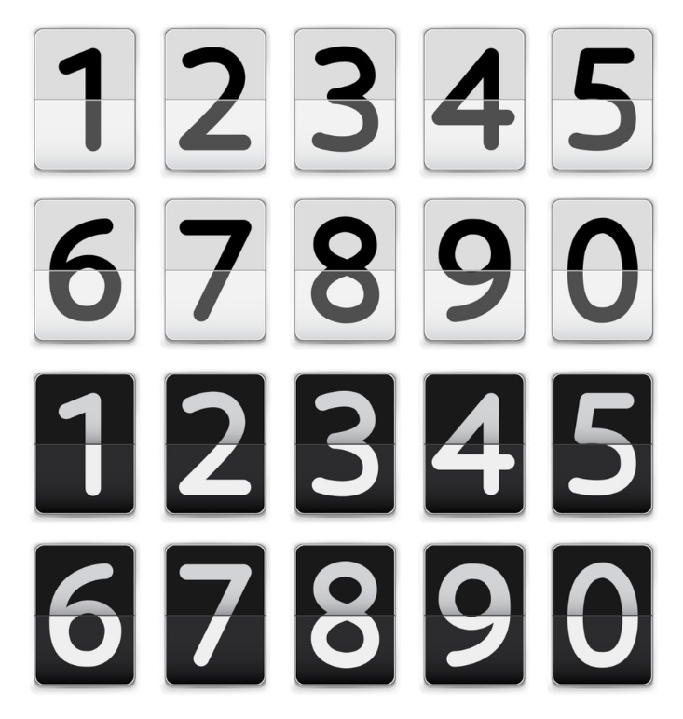
Tinkering
Implement the Rusty Ruler example files.
Add an “Inventory” page that shows how many of each item are in stock.
How could you implement the stock count as images instead of text?

